Slide 1
Sonic Evolution
Tenjing Norsang

Slide 2

Introduction
Sonic Evolution is a 2D/3D platformer starring Sonic the Hedgehog.
Built in Unity
Focus on coding / level design
Important to me because Sonic is my favorite gaming character and the reason I aspire to be a game designer.

Slide 3

Introducing Sonic
Sonic is a chili dog loving hedgehog known for his incredible speed and righteous yet cocky attitude.
Sonic made his first official debut in his game, Sonic the Hedgehog (SEGA), on June 21, 1991.
Since then, there have been a total of 114 Sonic games released, including spin offs.

Slide 4


Introducing Sonic
As the years went by, Sonic went through changes with his design and abilities in response to factors like technological advances (2D → 3D) and modern trends.

Slide 5
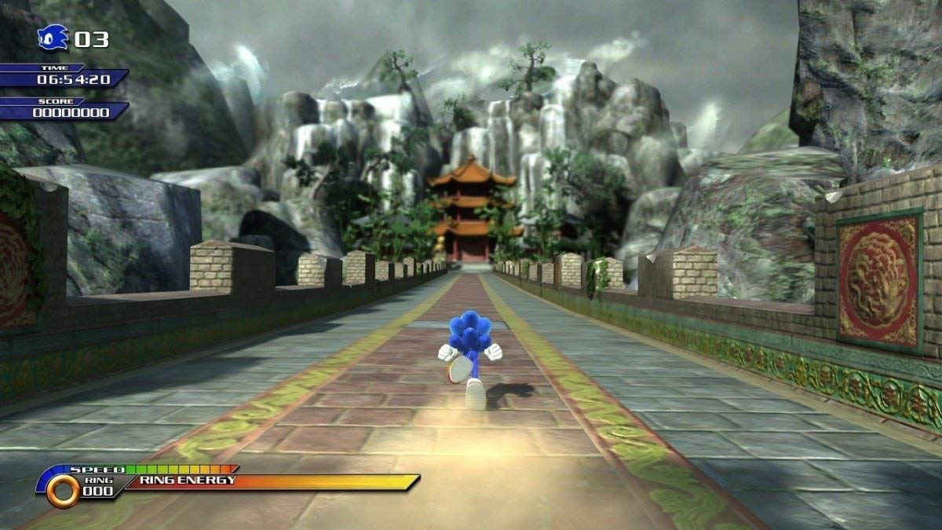
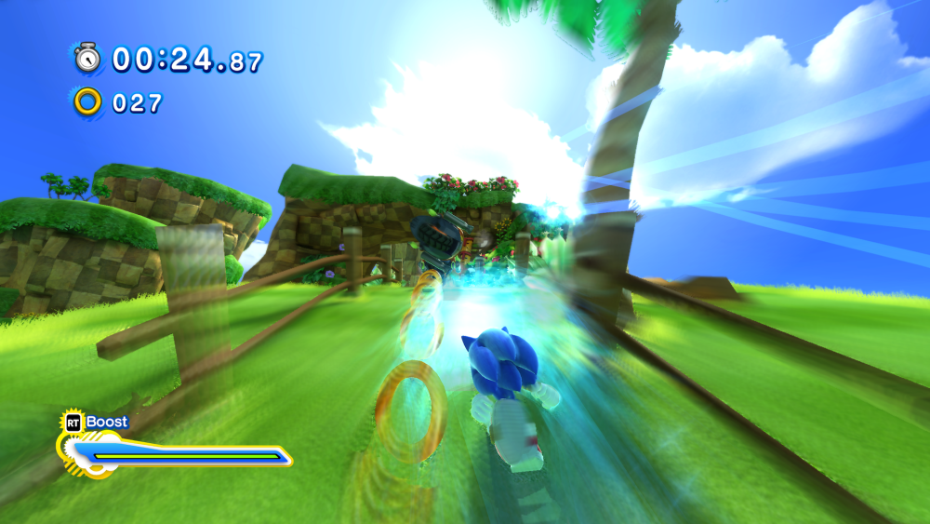
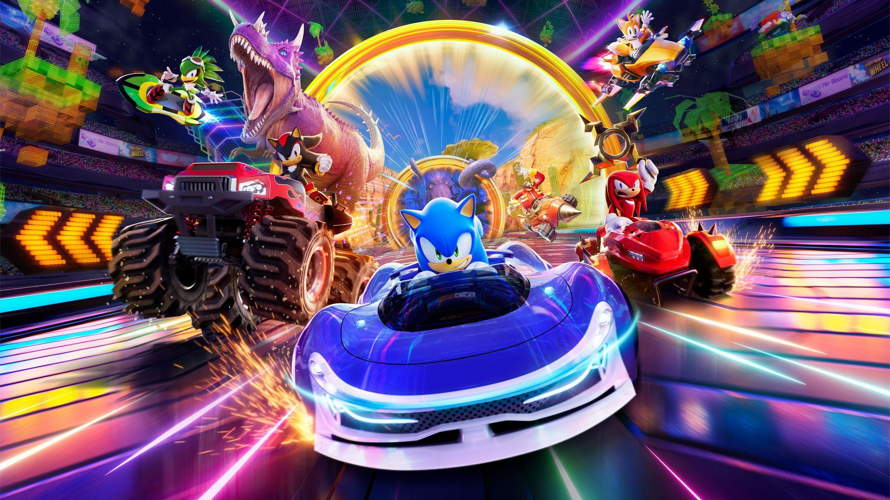
Inspirations (Official Games)
Sonic Unleashed (2008)
Sonic Generations (2011)
Sonic Crossworlds (2025)

Slide 6
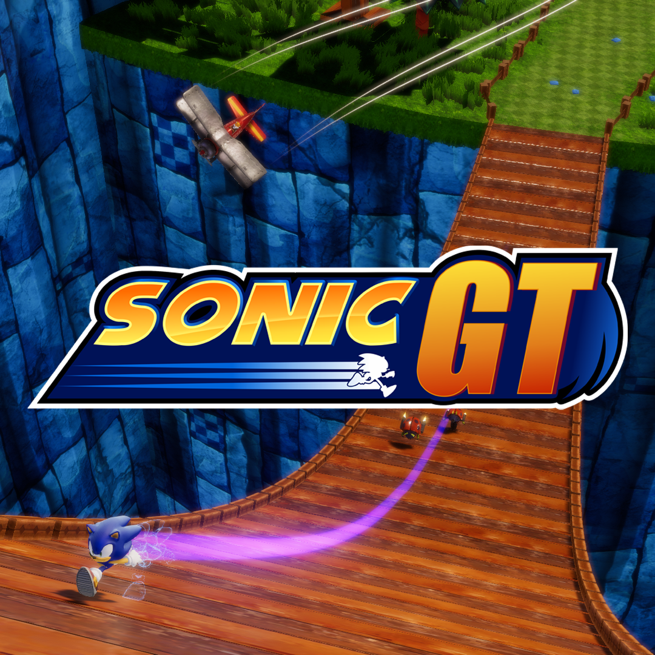
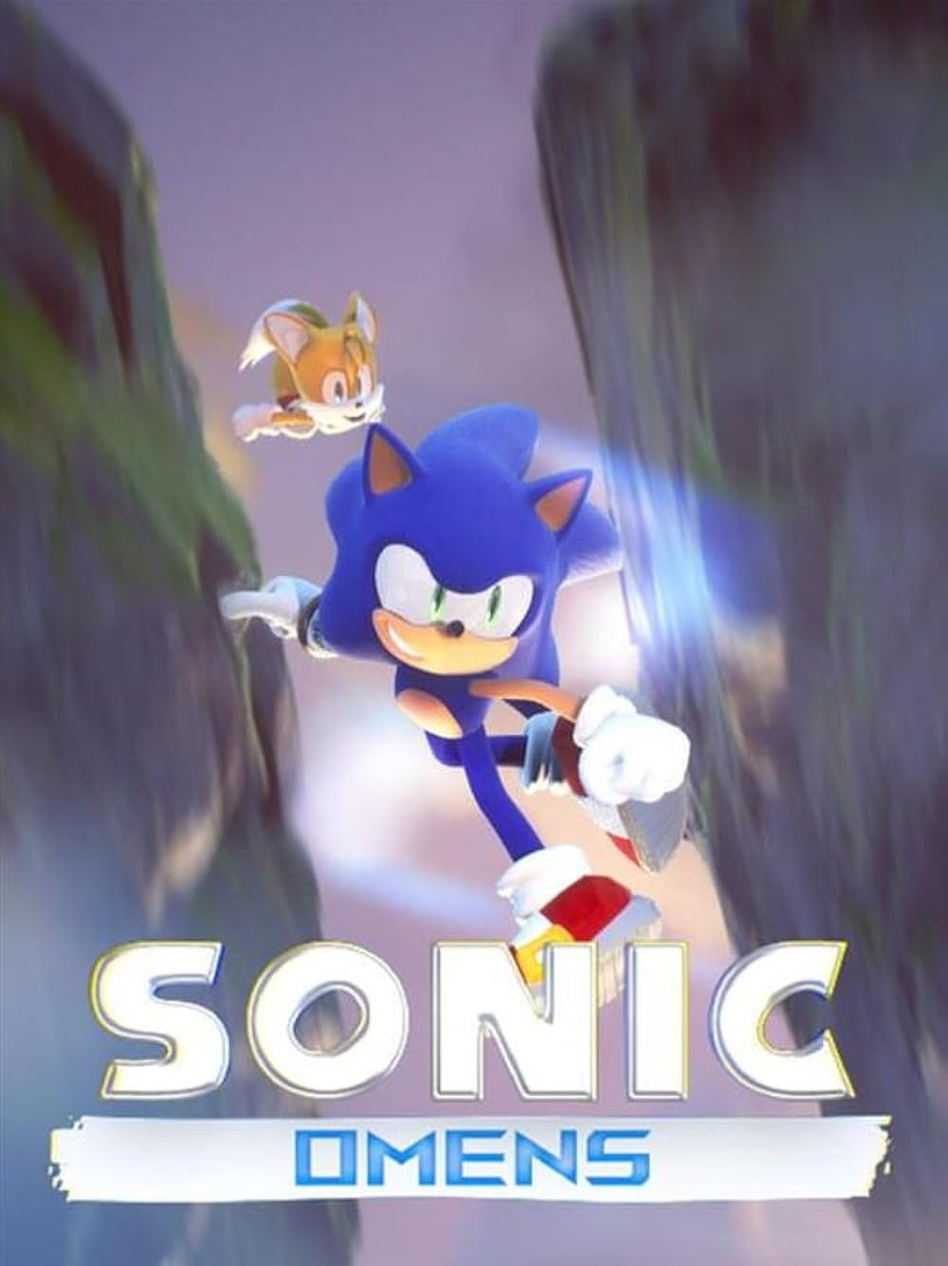
Inspirations (Fan Games)
Sonic GT (2020)
Sonic Omens (2022)

Slide 7
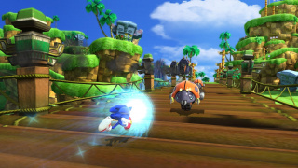
Sonic Evolution Concept
Sonic’s memories have been stolen by an unknown entity. Sonic will have to blast through familiar areas to collect his forgotten memories back.
Players will speed through one level that pays homage to the entire Sonic the Hedgehog series.
Different areas in Sonic’s history will be separated by portals.
Areas will contain memory capsules containing an ability that was introduced in the respective game of that area.
The game will be jam packed with enemies, areas, and easter eggs from all across Sonic’s history.

Slide 8
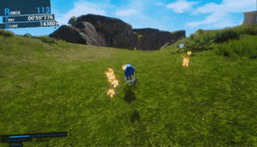
Sonic’s Abilities - Running
As Sonic moves, he will gain speed.
Game Introduced: Sonic the Hedgehog (1991)

Slide 9
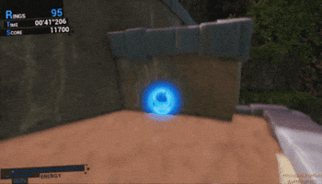
Sonic’s Abilities - Jumping
Sonic can jump to reach higher areas or avoid obstacles. When he does so he curls up into a ball. Any enemies that collide with Sonic as he jumps are destroyed.
Game Introduced: Sonic the Hedgehog (1991)
After jumping, Sonic can perform a double jump.
Game Introduced:
Sonic the Hedgehog 3 & Knuckles (1994) (With Lightning Shield)
Sonic Colors (2010) (Naturally)

Slide 10
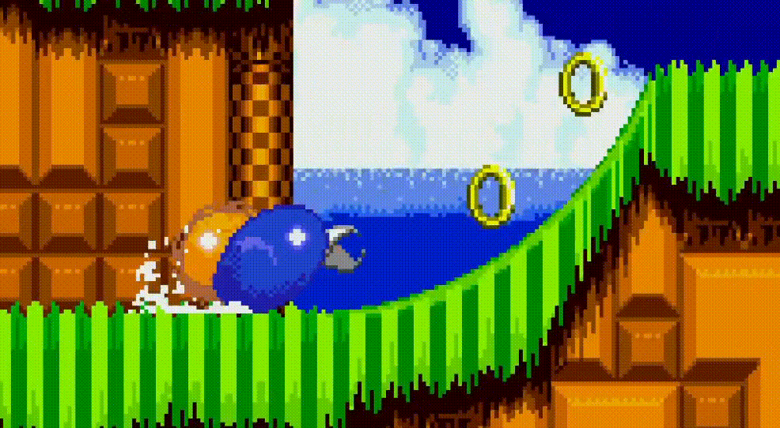
Sonic’s Abilities - Spindash
Sonic can charge up a Spindash. After charging, Sonic will propel forwards in ball form. Any enemies in his path are destroyed.
Game Introduced: Sonic the Hedgehog 2 (1992)

Slide 11
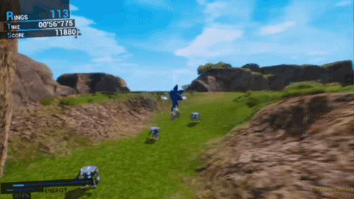
Sonic’s Abilities - Homing Attack
While in the air, if a target is available, a reticle will hover on it. Sonic can home in on that target at extreme speeds.
Game Introduced: Sonic Adventure (1998)

Slide 12
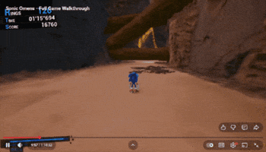
Sonic’s Abilities - Light Speed Dash
If there is a trail of rings, Sonic can perform a light speed dash. The light speed dash propels Sonic through the trail of rings.
Game Introduced: Sonic Adventure (1998)

Slide 13
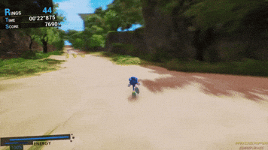
Sonic’s Abilities - Boost
By holding down the boost button, Sonic reaches top speed immediately and becomes near invincible, blowing away any enemies in his path. He can also run on water while boosting. As Sonic boosts, he will lose energy from his boost gauge (bottom left). Without energy Sonic can not boost. He can gain energy back by collecting rings or destroying enemies.
Game Introduced: Sonic Unleashed (2008)

Slide 14
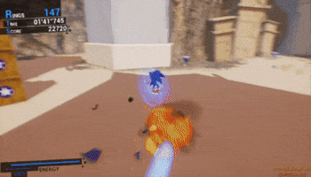
Sonic’s Abilities - Stomp
While in the air, Sonic can perform a stomp. It stops all of his momentum and causes him to go straight downwards. Any enemies or obstacles that collide with Sonic while he is stomping are destroyed.
Game Introduced: Sonic Unleashed (2008)

Slide 15

Initial Prototype (First Semester)
By the end of this semester, I want to have a playable Sonic with most of his abilities coded into Unity. I also hope to get a few basic enemies out of the way.

Slide 16
Final Prototype (Second Semester)
With Sonic coded into Unity, I would then focus on level design and asset development. There will be one playable level with enemies ready by the end of the semester.

Slide 17

Challenges
Building Sonic from the ground up.
First time using assets to design a level.
Rigging 3D animations.
Merging multiple areas into one level

Slide 18
Milestones
First Semester
Playable Sonic Character
Basic Enemies
Second Semester
Level Design
Asset Development

Slide 19
Questions?

